Slide 1
Energy Balance, Exercise, and Weight Control
Chapter 14

Slide 2

Objectives
Describe obesity trends in the United States
Compare and contrast extreme diets (i.e. Atkins, South Beach, VLCDs)
Explain weight loss and weight gain recommendations for athletes

Slide 3
Obesity in the United States
Increasing in all regions
In 2010, only 1 had obesity prevalence rates less than 20% (Colorado)
Obesity rates in AL, AR, KY, MS, MI, MO, OK, SC, TN, TX & WV exceeded 30%
Overweight occurrence particularly affects women and minority groups
Notes:
Overweight is a BMI of 25 to 29.9, and obesity is a BMI equal to or greater than 30.

Slide 4
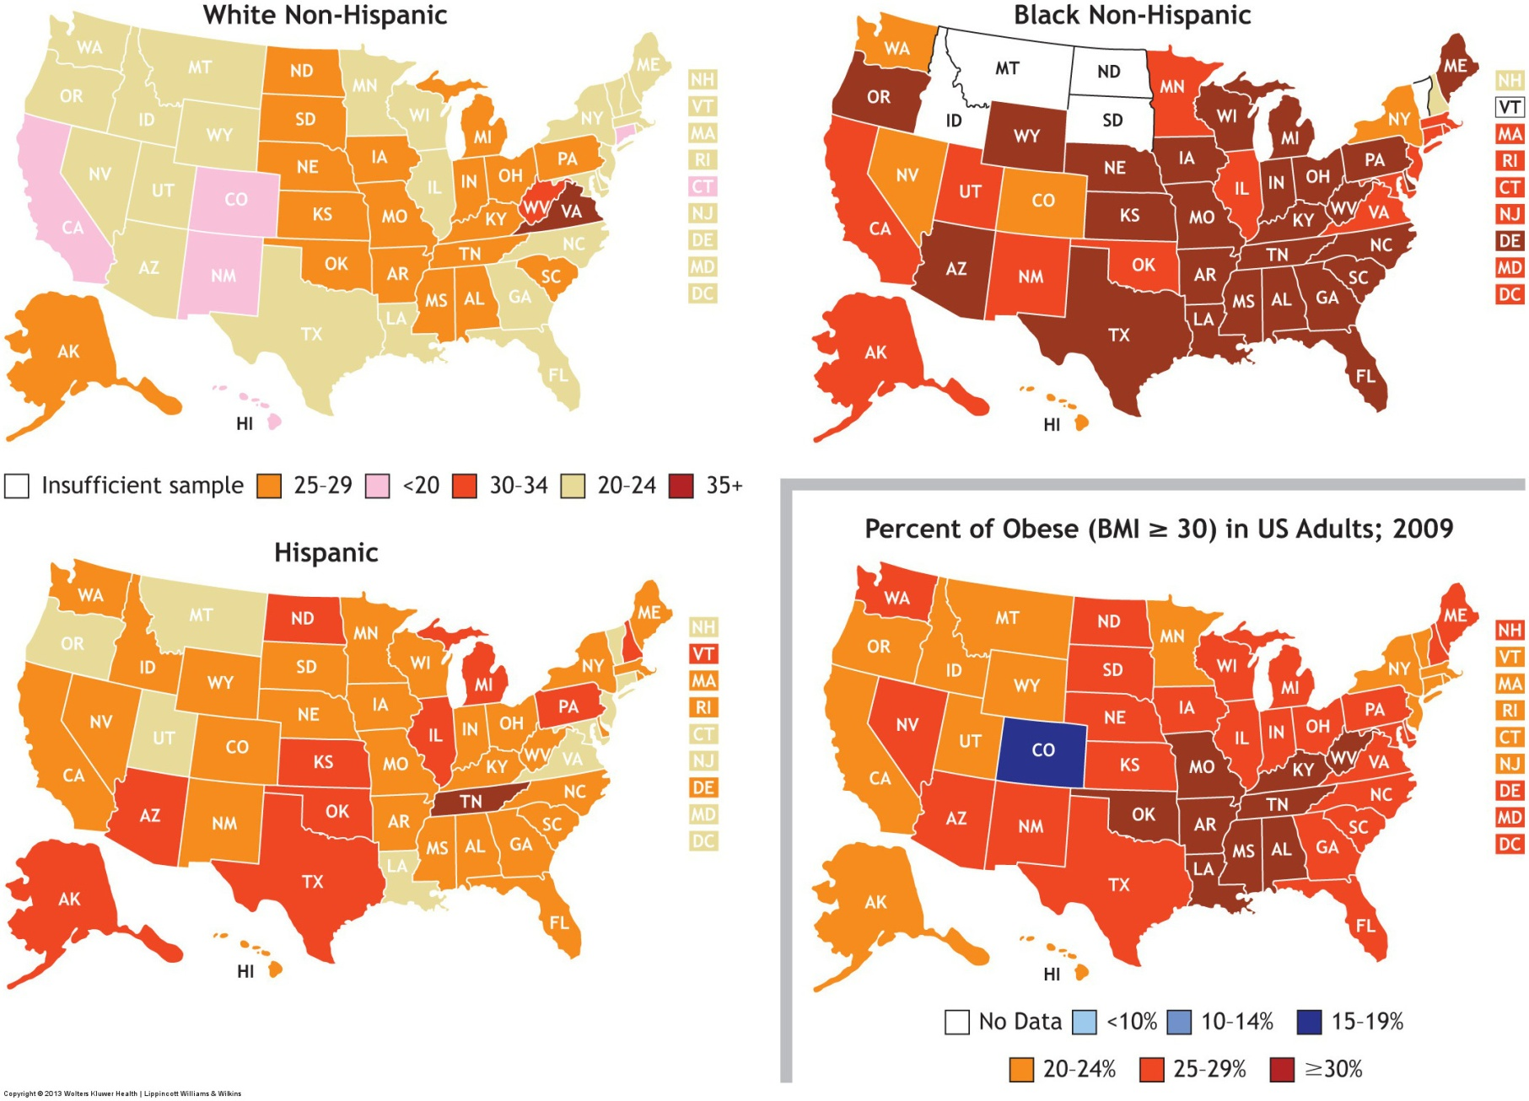
Notes:
State-specific percentages of US adults categorized as obese by black/white race or Hispanic ethnicity.

Slide 5
Facts About The Global Obesity Epidemic
Has more than doubled worldwide since 1980
In 2008, 1 in 10 adults worldwide was obese
65% of the world’s population lives in countries where overweight and obesity kill
By 2015, ~2.3 billion adults will be overweight and more than 700 million will be obese

Slide 6
Financial Impact of Obesity
Excess body fat represents the second leading cause of preventable death in the US
2010 there was a 140 billion cost of obesity-related disease
One doctor visit by 25% of the obese population would cost over 810 million

Slide 7
Health Risks of Obesity
2nd leading cause of preventable deaths in America
The estimated number of annual deaths attributed to obesity ranges between 280,000 and 325,000
Comorbidities include:
Hypertension
Elevated blood sugar
Pulmonary dysfunction asthma and sleep apnea
Postmenopausal breast cancer
Pancreatic cancer
T2dm and cvd

Slide 8
Physical Activity
Exerts a considerable influence in reducing risk for CVD and a more moderate effect on diabetes risk
Maintaining an elevated level of physical activity attenuates the age-related increases in body weight and body fat
Increased regular physical activity, should become the most important consideration in exercise prescription for weight control

Slide 9
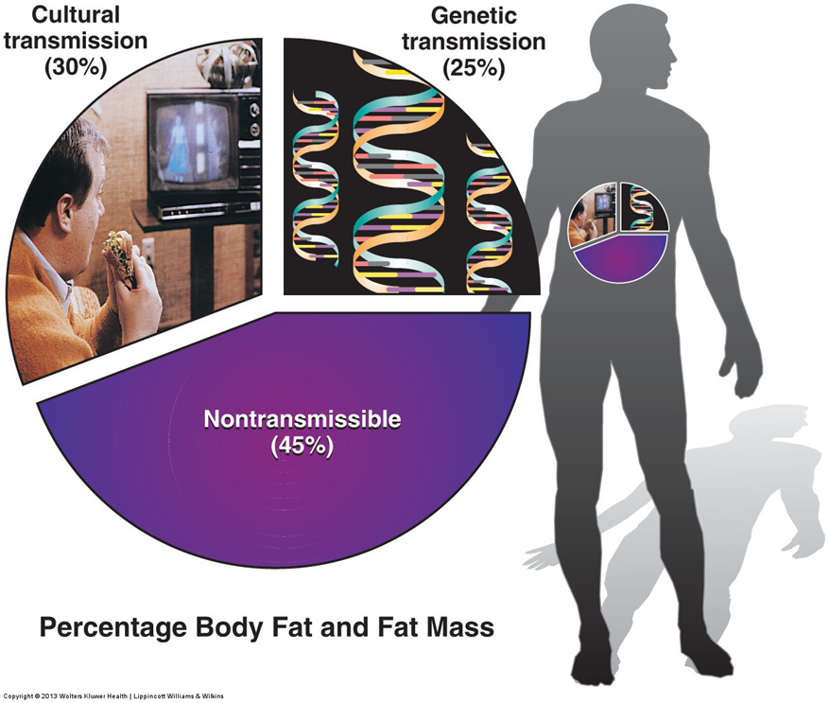
Genetics
Body weight should be viewed as the end result of complex interactions between one’s genes and environmental influences
Research with twins, adopted children, and specific segments of the population attributes up to 80% of the risk of becoming obese to genetic factors
Notes:
The greater prevalence of obesity among black women (about 50%) compared with white women (33%) frequently has been attributed to racial differences in food and exercise habits and attitudes toward body weight.

Slide 10
Mechanisms for Weight Gain
The mutation of gene called obese (ob) disrupts hormonal signals that regulate metabolism, fat storage, and appetite
Depressed leptin receptor sensitivity signals the brain that the body lacks fat reserves, often triggering overeating

Slide 11
Biochemicals That Influence Eating Behaviors
Leptin
Peptide YY3-36 (PYY)
Neuropeptide Y
Ghrelin
Melanocortin- 4
Notes:
• Leptin: Produced by adipocytes. Normal levels signal the hypothalamus to maintain food intake so body weight remains stable. Below normal leptin levels signal the brain to increase appetite so that body fat levels increase. Leptin also elevates metabolic rate.
• Peptide YY3-36 (PYY): Produced by intestinal cells in response to food intake. It then travels to the hypothalamus to inhibit the urge to eat. Overweight persons normally make less of this satiety signal than persons of normal body weight.
• Neuropeptide Y: A transmitter protein of the nervous system that stimulates food intake and regulates metabolism and fat synthesis.
• Ghrelin: Exerts effects opposite to those of leptin. A powerful appetite-stimulating hormone (also slows energy output) produced in the stomach and small intestine. Only known natural appetite stimulant made outside the brain. Drugs that block this hormone would not only stimulate weight loss but also increase energy expenditure.
• Melanocortin-4: Possibly supplies the signal to stop eating. About 10% of obese patients show genetic mutations in the gene that regulates this compound.

Slide 12
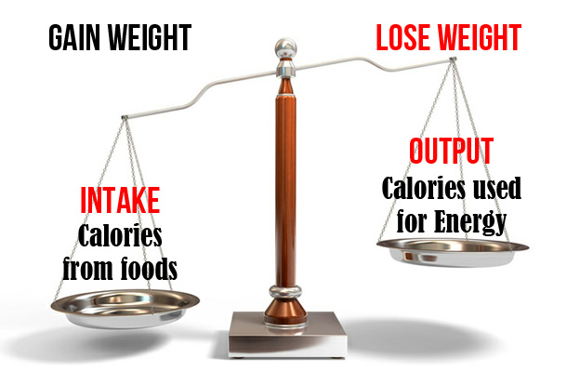
The Energy Balance Equation Applied to Weight Loss
If total daily food calories exceed daily energy expenditure, excess calories accumulate as fat
If energy expenditure exceeds the energy from food intake, body weight decreases

Slide 13
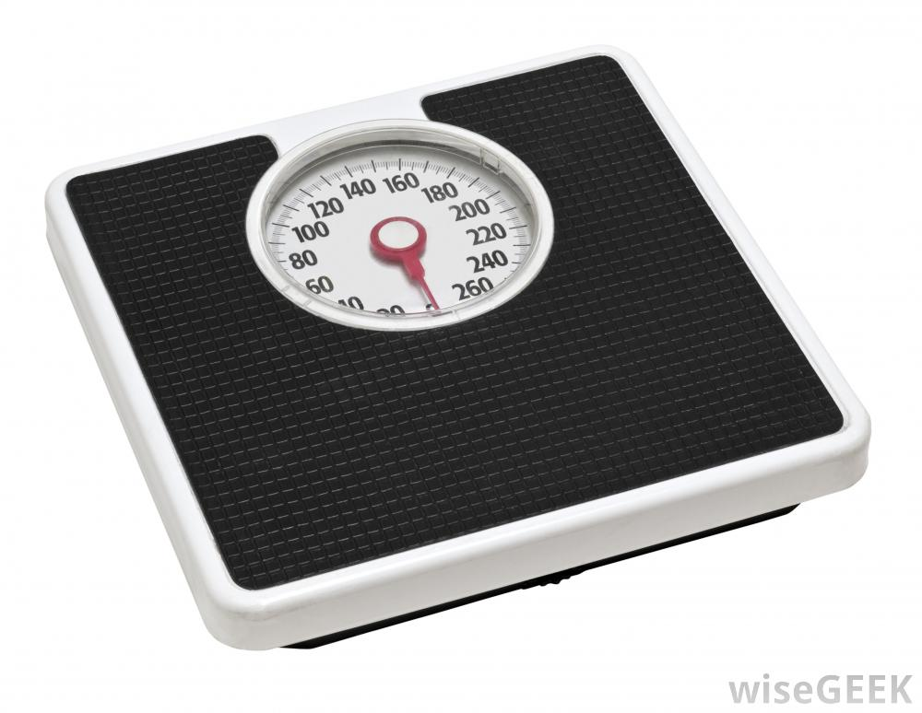
Dieting to Tip the Energy Balance Equation
Weight loss occurs whenever energy output exceeds energy intake, regardless of the diet’s macronutrient mixture
Total energy intake, not diet composition, determines the effectiveness of weight loss with reduced-energy diets
Notes:
Moderately reduced food intake produces greater body fat loss in relation to the energy deficit than more severe energy restriction that exacerbates loss of FFM.

Slide 14
Set-Point Theory
All persons fat or thin have a well-regulated internal control mechanism located deep within the hypothalamus that maintains a preset level of body weight and/or body fat
Each time body fat decreases below one’s preset level, internal adjustments resist the change and attempt to conserve and/or replenish body fat
Notes:
For example, resting metabolism slows, and the individual becomes obsessed with food, unable to control the urge to eat.
Resting metabolism often decreases when dieting progressively produces weight loss.

Slide 15
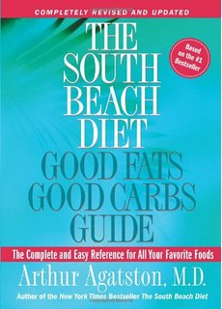


Extreme Diets
Low carbohydrate ketogenic diets
atkins
The south beach diet
High protein diets
Semi- starvation diests
very low calorie diets (VLCDs)
800 calories/day
Notes:
Low-carbohydrate ketogenic diets emphasize carbohydrate restriction while generally ignoring total calories and the diet’s protein, cholesterol, and saturated fat content.
Like the Atkins diet, the South Beach diet strictly limits intake of bread, potatoes, and other carbohydrates while permitting consumption of higher fat red meat, cheese, and eggs.
Dieting with a VLCD requires close supervision, usually in a hospital setting.

Slide 16
A Suitable Diet Plan
A calorie- counting approach to weight loss should provide an appropriate dietary plan that contains all the essential nutrients
Two factors largely determine one’s daily energy expenditure:
Resting energy requirement REE
Energy expended in daily physical activities
Notes:
Weight loss occurs if a true caloric deficit exists, and energy output exceeds energy input.

Slide 17

Maximizing Dieting’s Chances for Success
Human eating behavior is tied to both external (environmental) cues and internal (physiologic) cues
Both signals a need for food intake
A dieter must learn to make accurate appraisals or eating behavior
Quantity and frequency of eating
Specific circumstances linked to food intake

Slide 18
Behavioral Approaches Can Help
The person keeps records and answers the following 8 questions
When were meals eaten
In what place were meals eaten
What was the mood feeling or psychological state during the meal
How much time was spent eating
What activities were engaged in during the meal
Who was present during the meal
What food was eaten how much food was eaten

Slide 19
Developing New Techniques to Control Eating

Slide 20

Regular Physical Activity for Weight Control
Notes:
Additional spin-off from regular physical activity includes (1) slowing of the age-related loss in muscle mass, (2) improvement in obesity-related comorbidities, (3) decreased mortality, and (4) beneficial effects on existing chronic diseases.

Slide 21
Behavior Modification
Notes:
1. Progress slowly. Add additional exercise gradually. Over time, more opportunities to add physical activity become apparent.
2. Include variety. Rather than performing the same exercise repeatedly in a given time, vary the exercise and number of repetitions. For a competitive athlete, the added physical activity for weight loss need not be in the specific sport.
3. Become goal oriented. Set a specific and realistic goal for increasing physical activity. Three ways generally add additional exercise using goal-oriented behavior: (1) exercise for a certain length of time, (2) continue to exercise until you reach a predetermined number of repetitions or distance, or (3) manipulate exercise duration and repetitions or distance.
4. Be systematic. Set aside certain times during the day to exercise. Do not allow outside factors (e.g., watching television, shopping, housework) to interfere with daily physical activity.

Slide 22
Gender Difference in Exercise Effects on Weight Loss

Slide 23
Effects of Diet and Physical Activity on Body Composition During Weight Loss

Slide 24
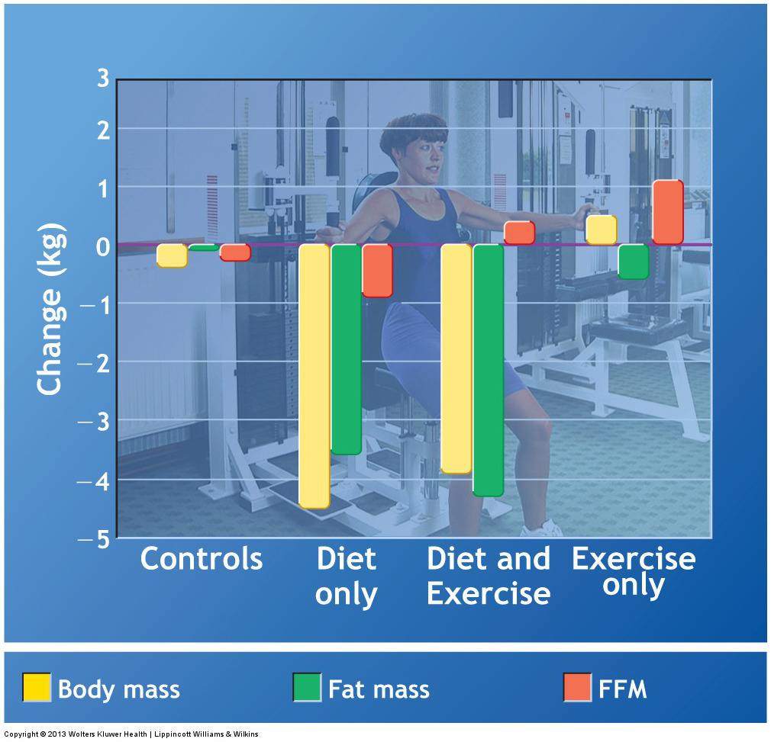
Notes:
Changes in body composition with resistance exercise and diet in obese females.

Slide 25
Weight Loss Recommendations for Athletes

Slide 26
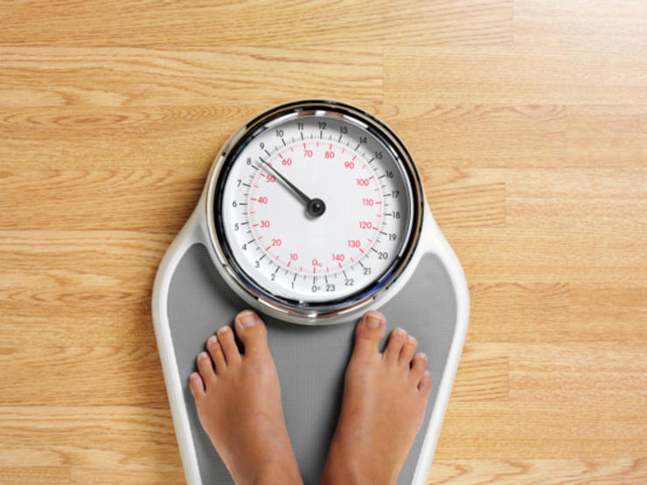
Weight Gain for Athletes
Increase protein to ______ body weight
Choose from plant and animal sources of protein:
Notes:
If all calories consumed in excess of the energy requirement of resistance training sustained muscle growth, then 2000 to 2500 extra kCal could supply each 0.5-kg increase in lean tissue.

